Slide 1
The Equivalent Point Load (via Integration)
Dr. Jacob Moore
Associate Professor of Engineering
Penn State Mont Alto

Slide 2
The Equivalent Point Load
Equivalent point load
The equivalent point load is a single point force that is statically equivalent to some original distributed force.
It would cause the same acceleration and angular acceleration as the original distributed force for an unconstrainted system
It would cause the same reaction forces as the original distributed force for a constrained system
Original distributed force

Slide 3
Why Use The Equivalent Point Load
Distributed forces are difficult to deal with directly in the equilibrium equations.
We would have integrals in our force and moment equations
Because of this, we usually convert the distributed force into it’s equivalent point load before proceeding with static or dynamic analysis.

Slide 4
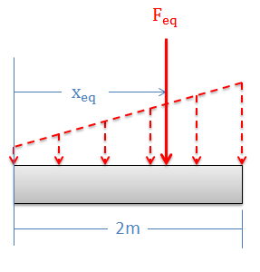
Finding the Equivalent Point Load
For any point force we must define...
The magnitude
The direction
The point of application
For now, we will only deal with distributed loads with a uniform direction, so the direction will just be maintained.

Slide 5
Finding the Equivalent Point Load
To determine the following...
The magnitude
The point of application
We have two options.
Calculation via Integration
Calculation via Composite Parts

Slide 6


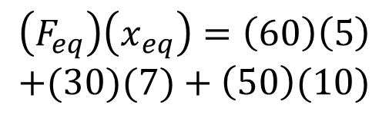

Statically Equivalent Systems (A lead-in to the Equivalent Point Load)
Imagine we have a cantilever beam with a few forces acting on the beam.
How might we find the magnitude and location of a single force that is statically equivalent to the original set of forces
$$F_{eq}=60+30+50$$
$$\left(F_{eq}\right)\left(x_{eq}\right)=\left(60\right)\left(5\right)$$
$$+(30)(7)+\left(50\right)(10)$$
$$F_{eq}$$
$$x_{eq}$$
60 N
50 N
30 N
5 m
2 m
3 m

Slide 7

The Equivalent Point Load via Integration
We can imagine a distributed force as an infinite number of very small forces.
Rather than summing all of these forces as we did before to find the magnitude of the equivalent point load, we will take the integral to find the area under the force function.

Slide 8
The Equivalent Point Load via Integration
An important first step is to define the force function “F(x)”.
In a 1-D problem like this, the force function will give you the magnitude of the distributed force (in units of force per given length) at any given value of x.
F(x) is the equation describing this curve at any given value of x

Slide 9
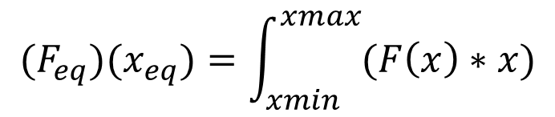
The Equivalent Point Load via Integration
Next, we will determine the point of application of the equivalent point load (x_{eq}), by knowing that the moment exerted by the original distributed force must be equal to the moment exerted by the equivalent point load.
To find the moment exerted by the distributed force, we use the moment integral, integrating the equation that is the force function times the distance (x).
$$(F_{eq})(x_{eq})=\int_{xmin}^{xmax}{(F\left(x\right)∗x)}$$

Slide 10
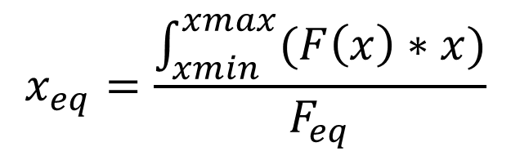
The Equivalent Point Load via Integration
By rearranging the equation from the previous slide, we can solve directly for the location of the force (x_{eq}).
$$x_{eq}=\frac{\int_{xmin}^{xmax}{(F\left(x\right)∗x)}}{F_{eq}}$$

Slide 11
Using the Equivalent Point Load
Once you have identified the magnitude and location of the equivalent point load, you can use the equivalent point load in further analysis (free body diagram / equilibrium equations / the equations of motion).
The one exception to this that you cannot use the equivalent point load when examining internal forces or moments

Slide 12
Discontinuous Force Functions
Occasionally we will come across a force function (F(x)) that cannot be written out as a single continuous function.
In cases like this we will split the function into sections, integrate each section in it’s given range, and add together the results.

Slide 13
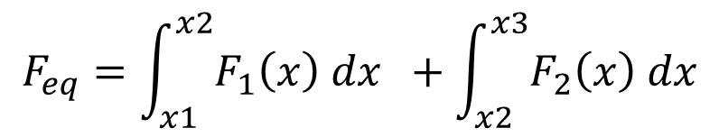


Discontinuous Force Functions
To find the magnitude of the equivalent point load, find the equation describing the magnitude of the force function for each section, then integrate each section within it’s respective range, then add together the two integrals.
$$F_{1}\left(x\right)$$
$$F_{2}\left(x\right)$$
x1
x2
x3
$$F_{eq}=\int_{x1}^{x2}{F_{1}\left(x\right) dx} +\int_{x2}^{x3}{F_{2}\left(x\right) dx}$$

Slide 14
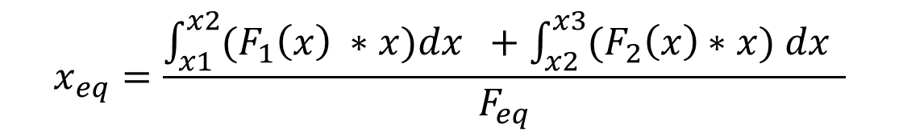
Discontinuous Force Functions
To find the location of the equivalent point load we can go through a similar procedure with the moment integrals.
$$F_{1}\left(x\right)$$
$$F_{2}\left(x\right)$$
x1
x2
x3
$$x_{eq}=\frac{\int_{x1}^{x2}{(F_{1}\left(x\right) ∗x)dx} +\int_{x2}^{x3}{(F_{2}\left(x\right)∗x) dx} }{F_{eq}}$$

Slide 15

The Equivalent Point Load for Surface Forces
Now we will look at a force spread over two dimensions (x and y).
Again, the first step is to define the force function.
This will a function describing the pressure at a given x and y value.
z
y
x
$$F\left(x,y\right)=5x+10y$$

Slide 16
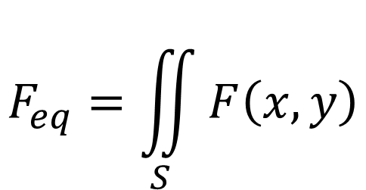
The Equivalent Point Load in Surface Force Problems
The volume under the force function is the magnitude of the equivalent point load.
We need to integrate the force function over the surface the force is applied to in order to find this volume.
z
y
x
$$F_{eq}=\iint_{S}{F\left(x,y\right)}$$

Slide 17
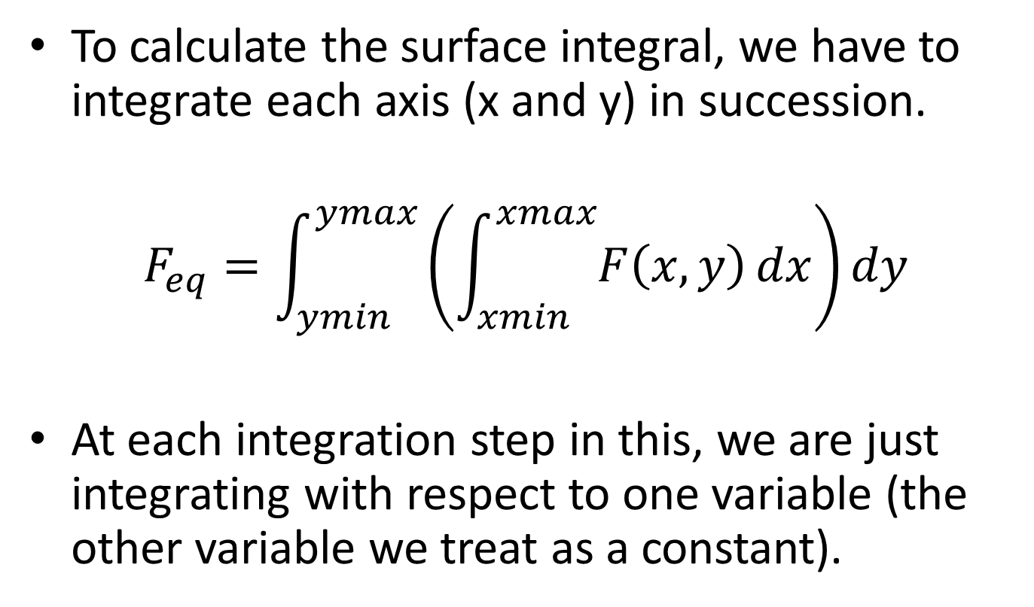
Calculating the Surface Integral
To calculate the surface integral, we have to integrate each axis (x and y) in succession.
$$F_{eq}=\int_{ymin}^{ymax}{\left(\int_{xmin}^{xmax}{F\left(x,y\right)}dx\right)}dy$$
At each integration step in this, we are just integrating with respect to one variable (the other variable we treat as a constant).

Slide 18
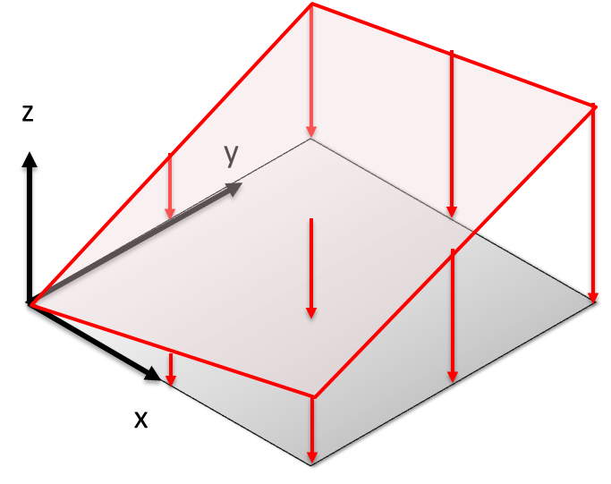
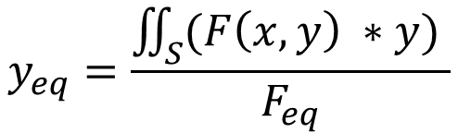
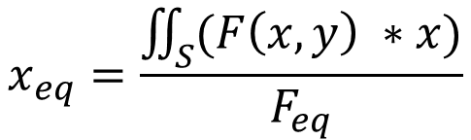
The Equivalent Point Load in 2-D Surface Force Problems
To find the point of application of the equivalent point load, we now need two numbers (the x and y coordinates).
We multiply the force function by x for the x coordinate and the force function by y for the y coordinate.
$$x_{eq}=\frac{\iint_{S}^{ }{(F\left(x,y\right) ∗x)}}{F_{eq}}$$
$$y_{eq}=\frac{\iint_{S}^{ }{(F\left(x,y\right) ∗y)} }{F_{eq}}$$

Slide 19
Thanks for Watching
See other engineering mechanics videos and access the full tool at…

Slide 20
Equivalent Point Load via Integration Worked Example
Determine the magnitude and location of the equivalent point load for the distributed force shown below using composite parts.
14 kN/m
3 m
7 m

Slide 21
Equivalent Point Load via Integration Worked Example
Determine the magnitude and location of the equivalent point load for the parabolic distributed force shown below. (assume a slope of zero at the wall)
1800 lbs/ft
3 ft

Slide 22
Equivalent Point Load via Integration Worked Example
An empty truck trailer with a weight of 17000 lbs is subjected to the wind force shown to the right. Assuming the weight acts in the middle of the trailer, what is the expected normal forces at the tires on the left and the tires on the right?
700 lbs/ft
9 ft
400 lbs/ft
2 ft
A
B
8 ft

Slide 23
Equivalent Point Load via Integration Worked Example
Determine the magnitude and location of the equivalent point load for the distributed force shown below using integration.
10 kN/m
5 m
5 m

Slide 24
Equivalent Point Load via Integration Worked Example
Determine the magnitude and location of the equivalent point load, then use that to find the magnitude of the reaction forces at A and B.
6 kN/m
4 kN/m
A
B
6 m
6 m

Slide 25
Equivalent Point Load via Integration Worked Example
A surface pressure is acting over a 5-meter square area. The magnitude of the pressure, in kPa, is described by the function to the right. Find the overall magnitude of the force exerted and the location of the equivalent point load.
z
y
x
$$F\left(x,y\right)=5x+10y$$

Slide 26
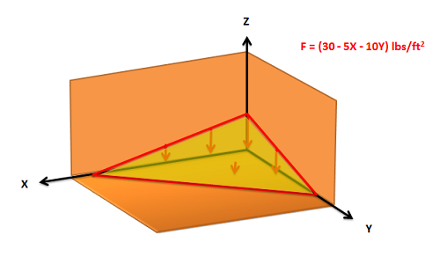

Equivalent Point Load via Integration Worked Example
The wind has piled up sand into a corner on a building. The building supervisor is worried about the weight of the sand pushing against the roof of the basement below. The function describing pressure of the sand pushing down on the surface (in pounds per square foot) is given below. Find the magnitude, direction and point of application of the equivalent point load.
$$F\left(x,y\right)=30 −5x−10y$$

